Slide 1
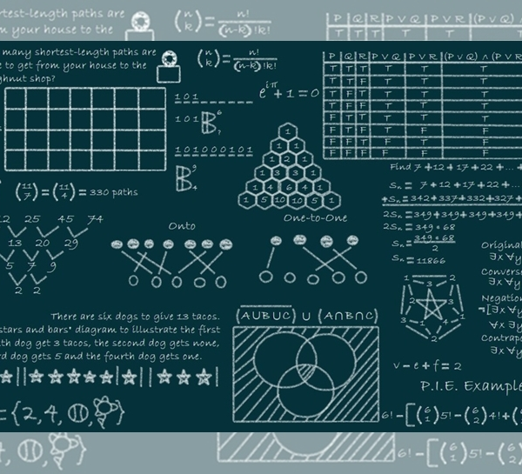
BAS: Beetle Antennae Search Algorithm for Optimization Problems
機器人三甲
CBC106013

Slide 2

Meta-Heuristic Algorithm
Beetle Antennae Search Algorithm(BAS)
Enlighten
Design
Process

Slide 3
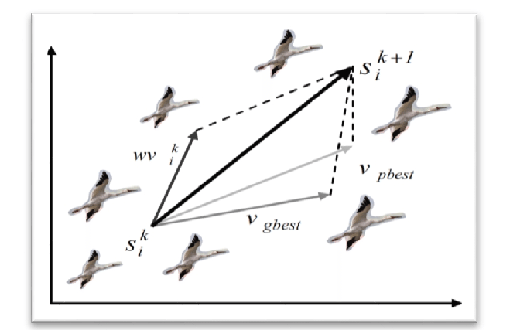
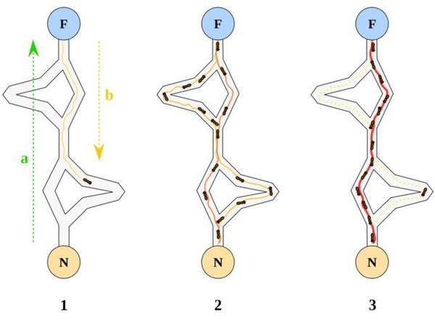
Meta-Heuristic Algorithm
smart random search
Enlighten from nature
Flock of birds -> PSO
Flock of ants -> ACO

Slide 4
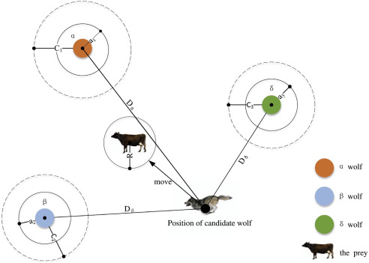
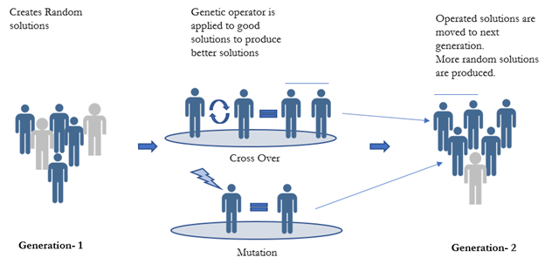
Meta-Heuristic Algorithm
Flock of wolfs -> GWO
gene -> GA

Slide 5
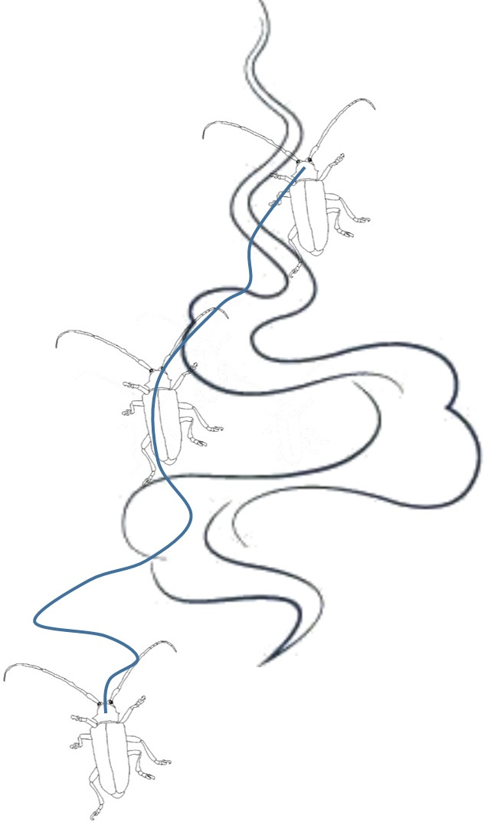
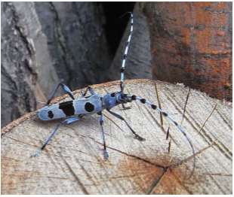
Beetle Antennae Search Algorithm (BAS)
Enlighten

Slide 6
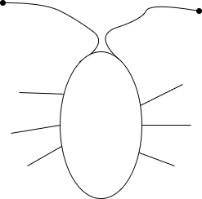

Beetle Antennae Search Algorithm (BAS)
Design

Slide 7
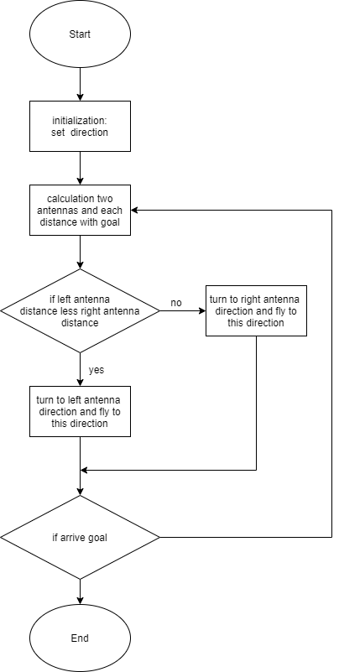
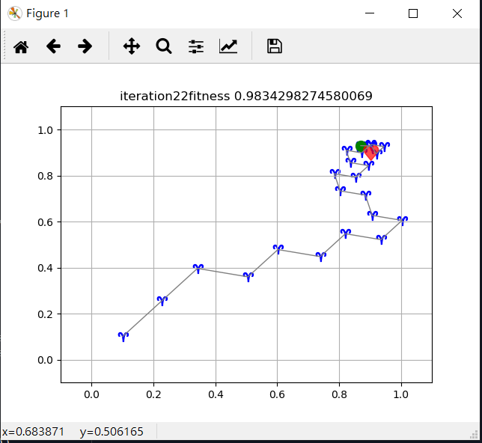
Beetle Antennae Search Algorithm (BAS)
Process

Slide 8
原文
原作者Xiangyuan Jiang, Shuai Li

